Slide 1

Full Waveform Sonic
Challenges in hard rock
2/25/2015
Andrew Greenwood – Curtin University, Perth Australia - A.Greenwood@curtin.edu.au
Christian J Dupuis – Université Laval, Québec.
Sana Zulic – HiSeis, Perth Australia.

Slide 2
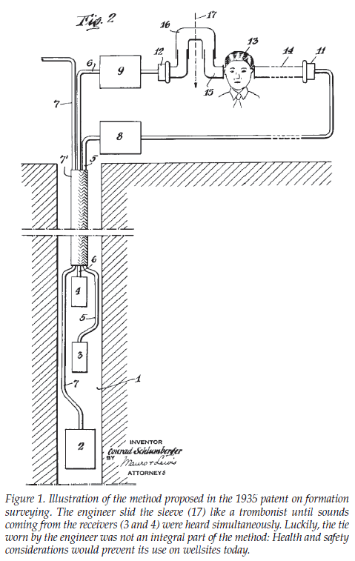
Brief History
Fundamental connection with VSP and surface seismic relating time to depth.
Interval velocity measurement
link the well bore scale (petrophysical) to the seismic scale
correlation to observed reflections
First check shot VSP’s 1927 (Geophysical Research Company)
Conrad Schlumberger patent 1935 1 Transmitter (Tx) and 2 recievers (Rx)
Shell Humble 1951, first continuous velocity logging tool.
(Close et al. 2009)
Notes:
Third category of wireline logging as an accompaniment to seismic initially but soon became a tool for measuring mechanical rock properties and borehole conditions.

Slide 3
Acoustic logging applications
Shear wave analysis and porosity estimates – Petroleum industry
Wylie estimation of porosity
Formation fluid pressure
Petrophysical properties
Bulk, Shear Moduli, Poisson's ratio – Require density
Cement Bond Log
Reflected tube waves
Fracture and alteration
Seismic
Vp, Vs Vp/Vs
well ties and synthetics (requires density)

Slide 4
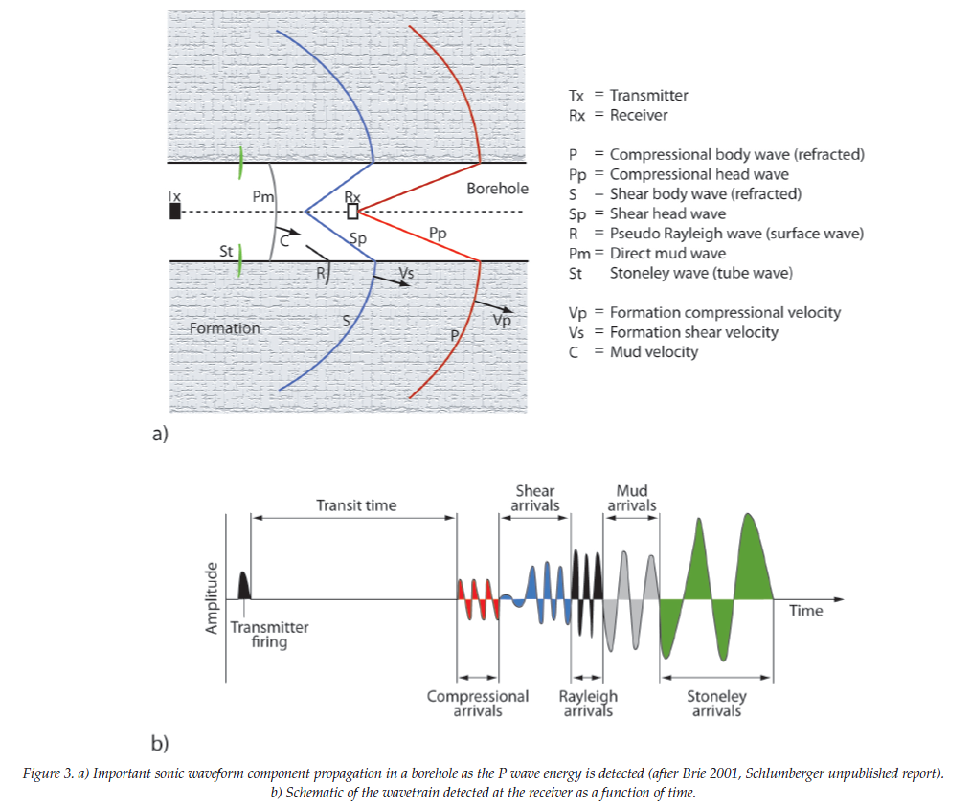
Principles – waves I
Tx compressional wave → borehole refracted compressional and shear waves → compressional head waves to the Rx.
Pseudo Rayleigh
Surface wave slightly slower than shear wave
Water/Mud wave
Usually not present as the borehole diameter is small w.r.t. to its wavelength
Stoneley/tube wave
Guided wave with large amplitude. Dispersive.
(Close et al. 2009)

Slide 5

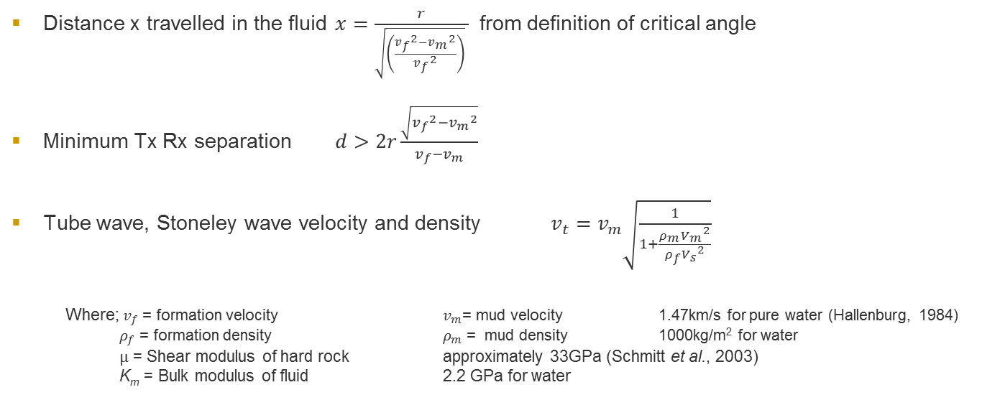
Principles – waves II
Distance x travelled in the fluid $x=\frac{r}{\sqrt{\left(\frac{{v_{f}}^{2}−{v_{m}}^{2}}{{v_{f}}^{2}}\right)} }$ from definition of critical angle
Minimum Tx Rx separation $d>2r\frac{\sqrt{{v_{f}}^{2}−{v_{m}}^{2}}}{v_{f}−v_{m}}$
Tube wave, Stoneley wave velocity and density $v_{t}=v_{m}\sqrt{\frac{1}{1+\frac{ρ_{m}{V_{m}}^{2}}{ρ_{f}{V_{s}}^{2}}}}$
Where; $v_{f}$ = formation velocity $v_{m}$= mud velocity 1.47km/s for pure water (Hallenburg, 1984) $ρ_{f}$ = formation density $ρ_{m}$ = mud density 1000kg/m² for water
µ = Shear modulus of hard rock approximately 33GPa (Schmitt et al., 2003)
K_{m} = Bulk modulus of fluid 2.2 GPa for water
m
m
Notes:
Can we get density if we know the mud density ($ρ_{m}$)?

Slide 6
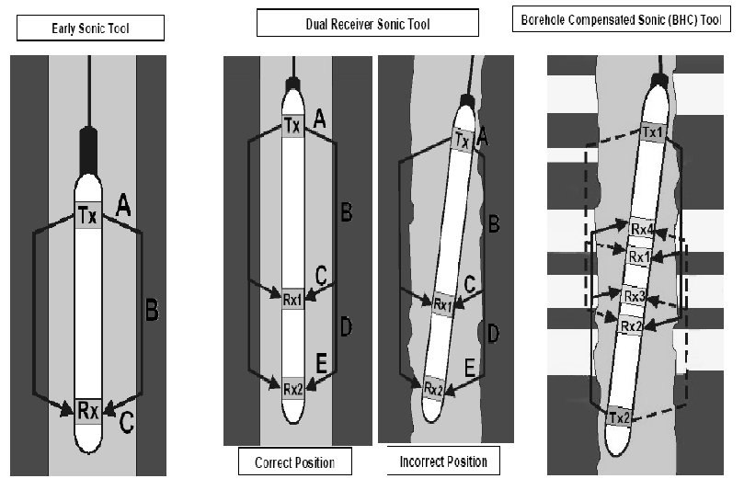
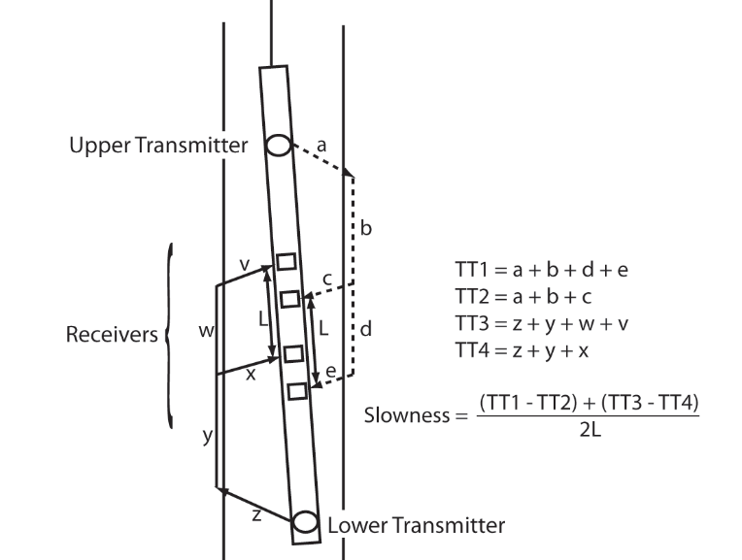
Configurations
1 Tx 2 Rx
1 Tx 3 or 4 Rx
Semblance processing
Compensated (2 Tx – 4 Rx)
Array Sonic Tool (Sonic Dipole)
1Tx, 8 Rx, Can record P, S and Stoneley waves

Slide 7
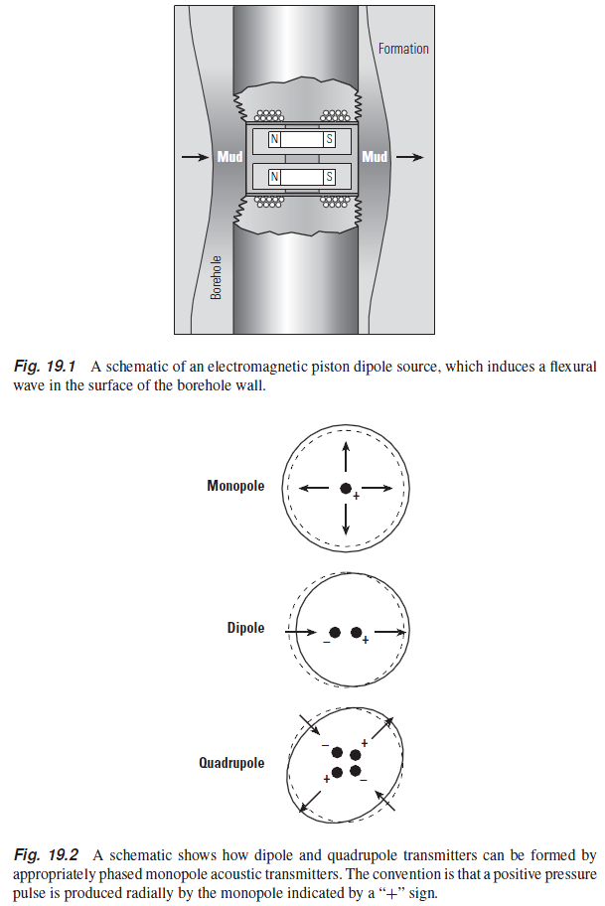
Principles – source and receivers
Transmitters Tx
Magnetostrictive torus, current coil wrapping toroidal (magnetized) core material Ceramic piezoelectric (BaTiO₂). Output power and operating frequency limited by the surface area and material properties- logging tool dimensions generally restrict this to 1-25 kHz.
Monopole (compressional waves),
Dipole and quadrupole can create flexural waves
Receivers Rx - Piezoelectric
Pressure sensors
Depth of penetration – Tx Rx separation
Alteration - Compressional waves in damaged zones are slower and if the transmitter to receiver distances are large enough, there is separation in measurements from the undamaged and damaged zones. This is because the faster deeper‐penetrating waves will arrive first, and the long spaced receivers have a greater chance of detecting the waves from the undamaged zone.
Notes:
Sources Magnetostrictive = torus, current coil wrapping toroidal (magnetized) core material or ceramic piezoelectric (BaTiO₂). Output power and operating frequency limited by the surface area and material properties- logging tool dimensions generally restrict this to 1-25 kHz. With piezo-electric sources when an electrical pulse is supplied it results in a “ringing” at the central frequency for several cycles/periods.
Dipole source give borehole flexural wave.
Pseudo geometrical factor for borehole condition / depth of investigation correction.
Longer spaced tool account for borehole conditions

Slide 8
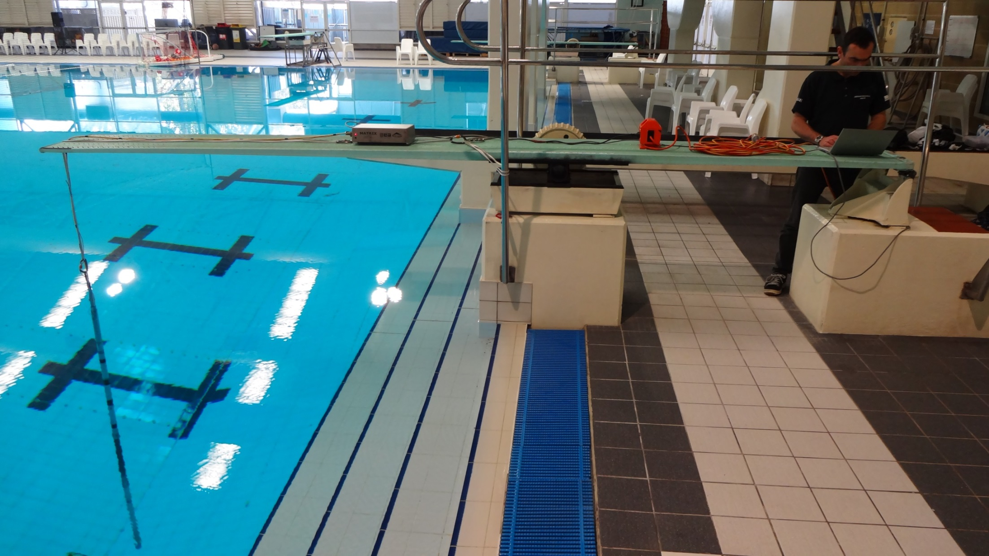
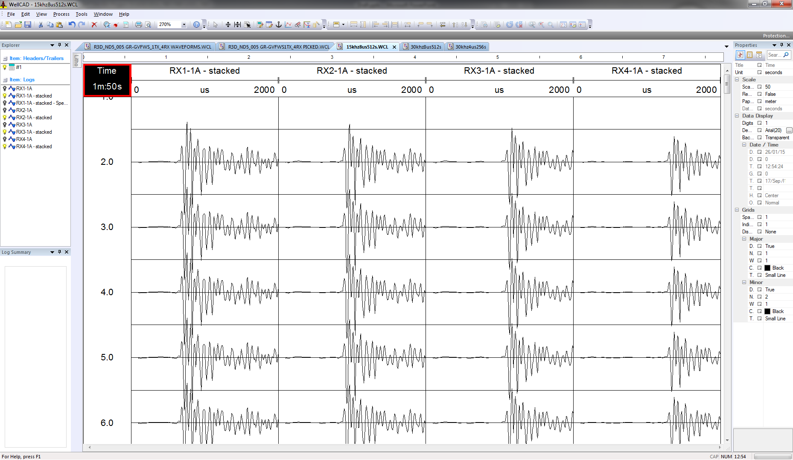
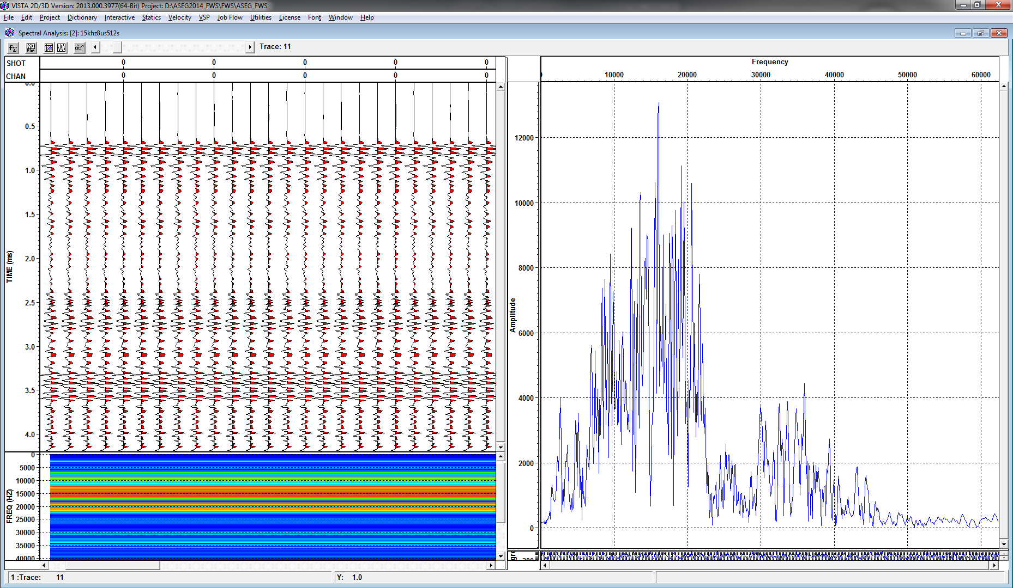
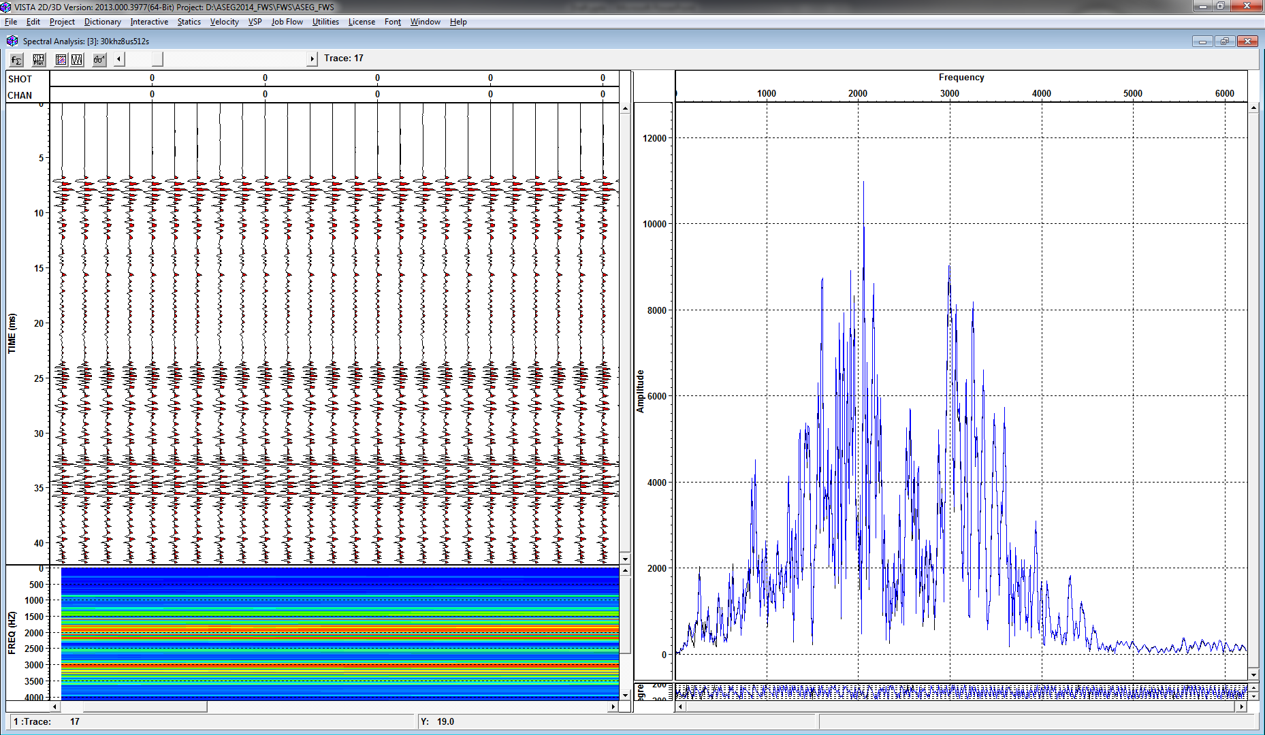
Source signature
15kHz signal in free water
15kHz spectrum
30kHz spectrum
Notes:
With piezo-electric sources when an electrical pulse is supplied it results in a “ringing” at the central frequency for several cycles/periods.

Slide 9
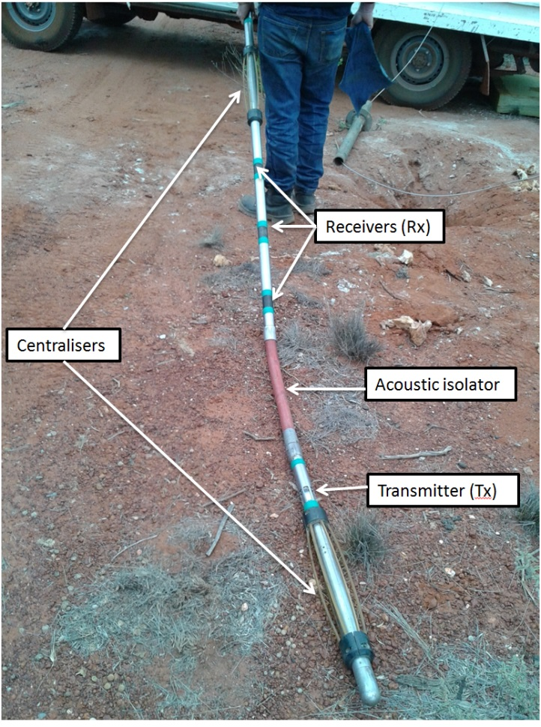
Acquisition
Parameters:
blanking, sample rate, stacking, record length, stacking and stacking interval
Maximum logging speed (m/ min) = sample interval(records/minute) packet time (seconds per record)
Centralisers
Tool length
Overlapping wavefields and hard rock velocities
Frequency

Slide 10


Cut-off frequency
Compressional wave surveys are conducted at frequencies above the cut-off frequency and Stoneley wave surveys are collected below the cut-off
The monopole source can be adopted in hard rock to determine both P-wave and S-wave velocity; the data quality also depends on the selection of the transmitter frequency: this must be high enough to excite high amplitude of P-wave. If the frequency is too high unwanted modes of head waves propagate along the borehole and make the received signal much more complicate to be processed and interpreted.
$$f_{c}=\frac{v}{D}$$
BQ
$v$ – velocity
NQ
HQ
PQ
↨ Tool Frequency ranges

Slide 11
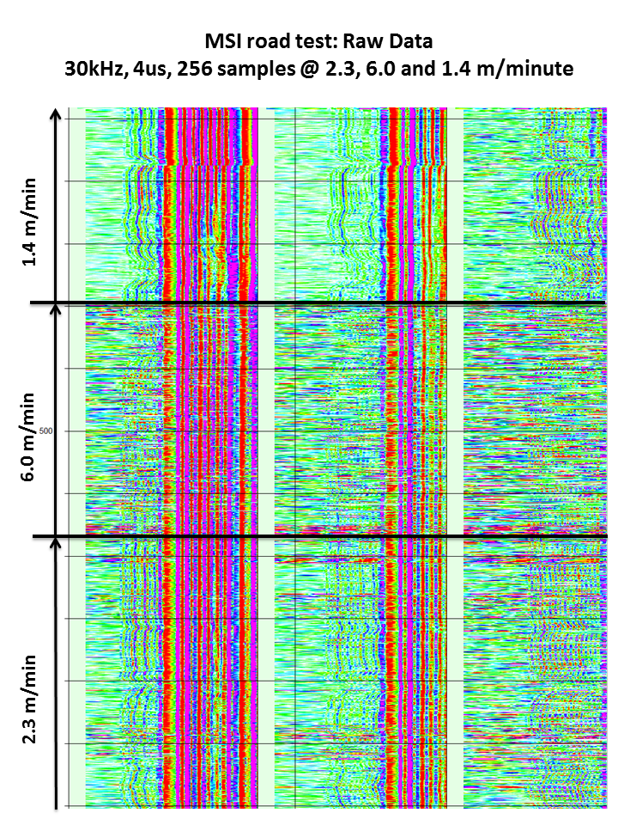
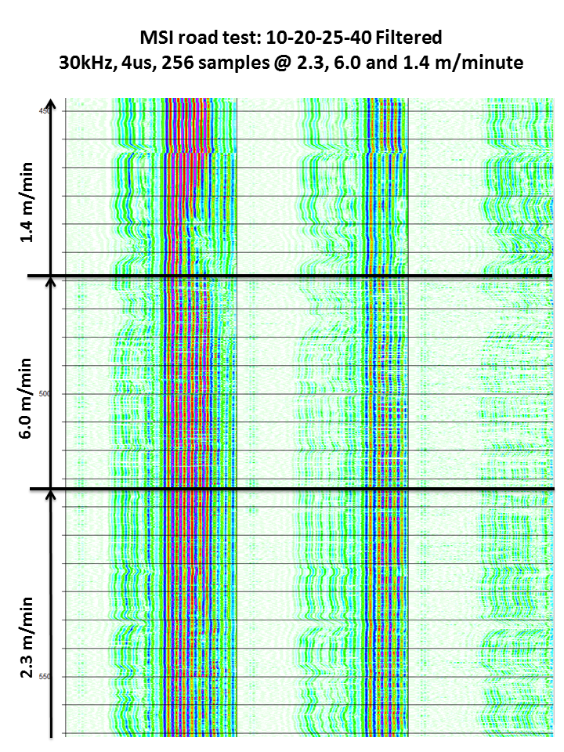
Road Noise

Slide 12
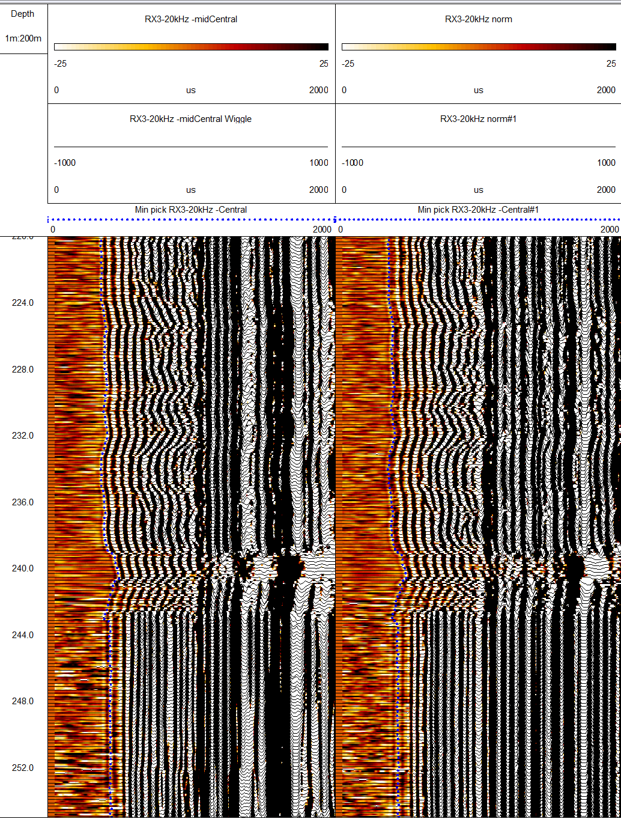
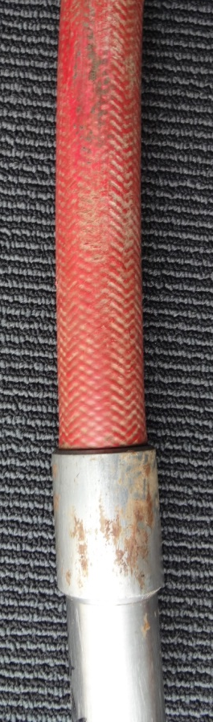
Increased Centralisation
PQ borehole
20 kHz MSI tool
2.0 m/min
85o borehole
Additional centraliser placed on the acoustic isolator to lift the coupling shoulders of the borehole wall
Additional centralisation
Standard centralization

Slide 13
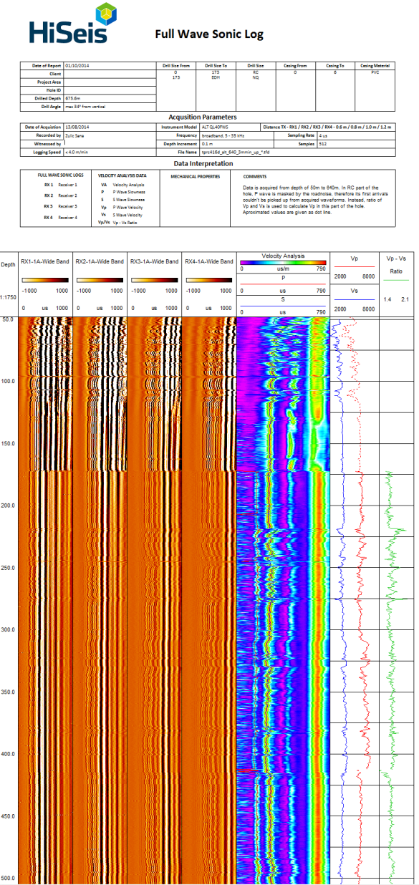
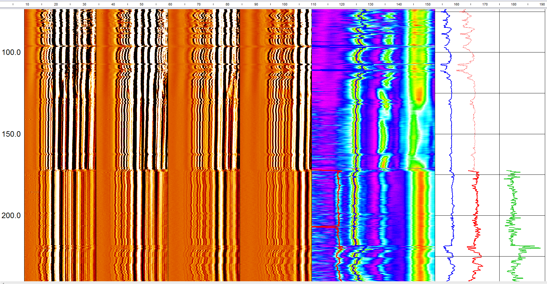
NQ to PQ transition
Non-centralised tool = loss of coherent compressional wave
PQ
NQ
P-wave slowness
S-wave slowness
Notes:
Semblance processing relies having a constant slowness across the receiver array.

Slide 14
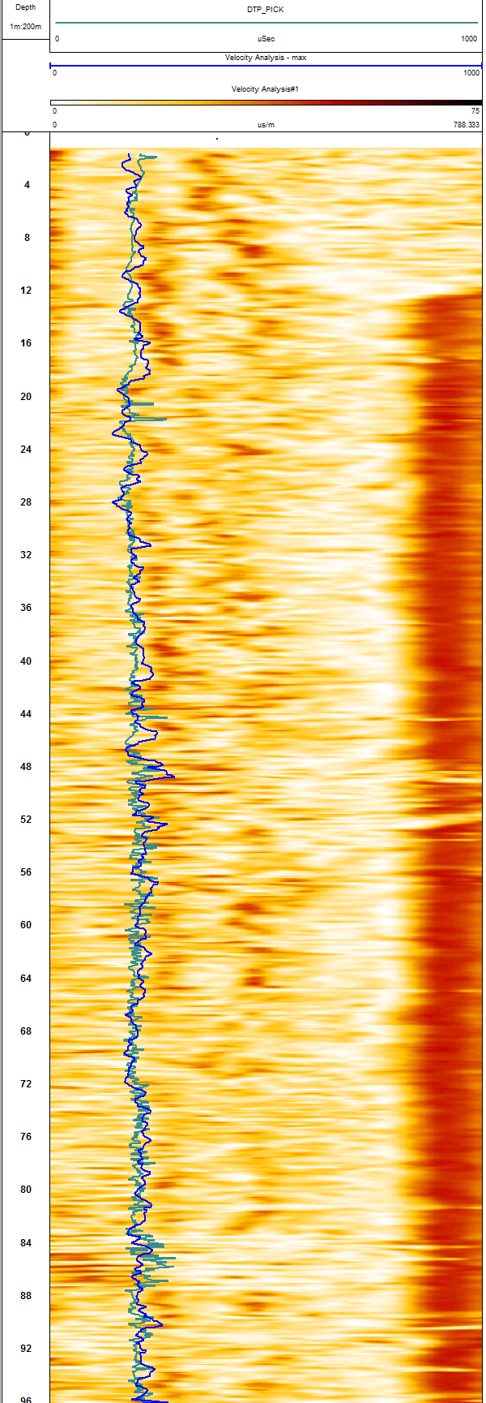
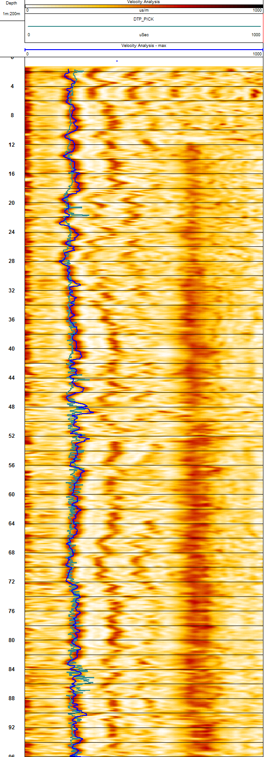
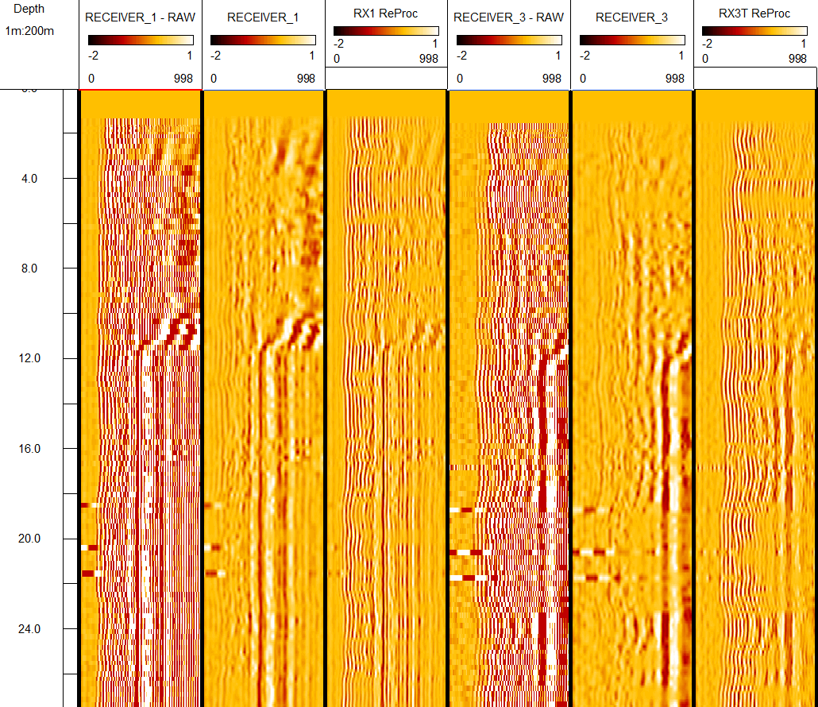
Processing
Bandpass Filters
Org Filter LC-0.0, LP 4.0, HP-23.0, HC 27.0
ReProc Filter LC-4.0, LP 10.0, HP-35.0, HC 45.0

Slide 15
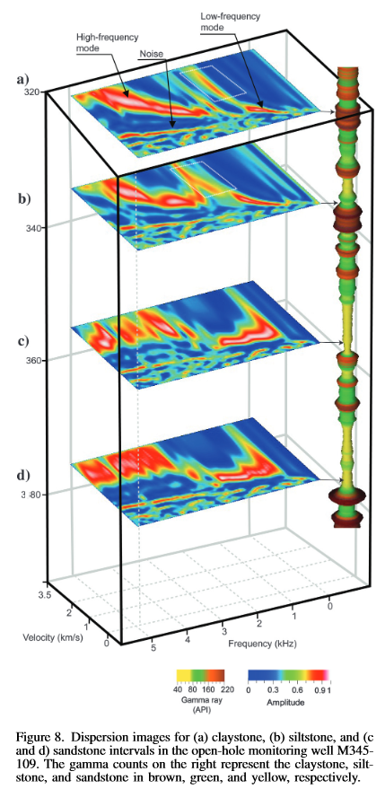
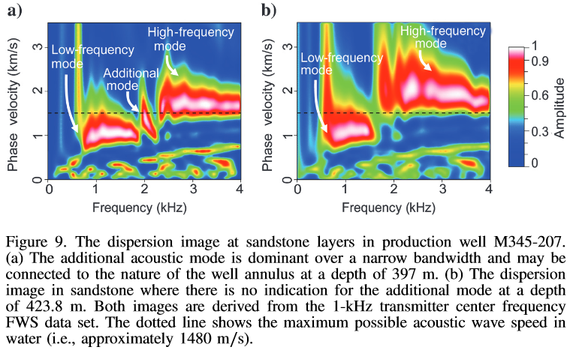
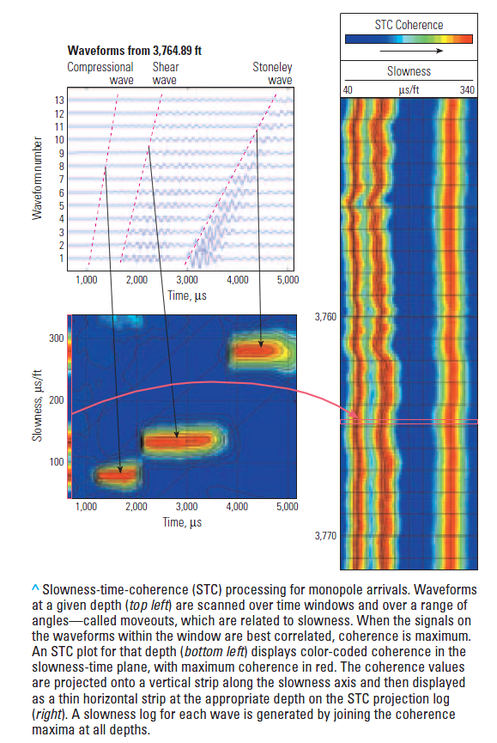
Processing
$fv$ dispersion analysis (Almalki, 2012)
Semblance Processing (Hornby, 1989)
Deconvolution?
(Haldorsen, 2006)

Slide 16
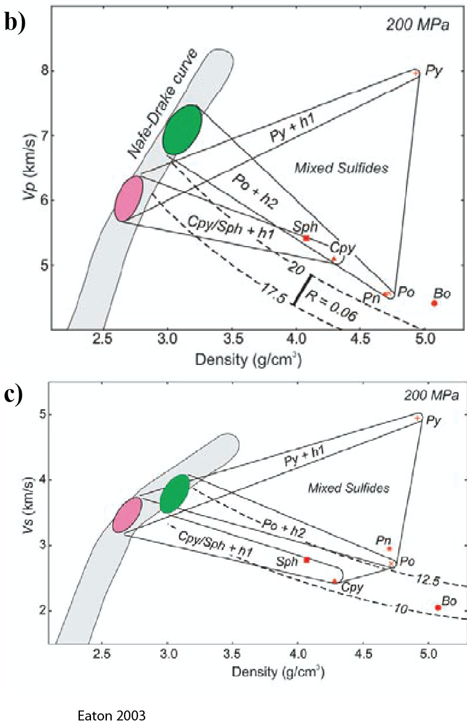
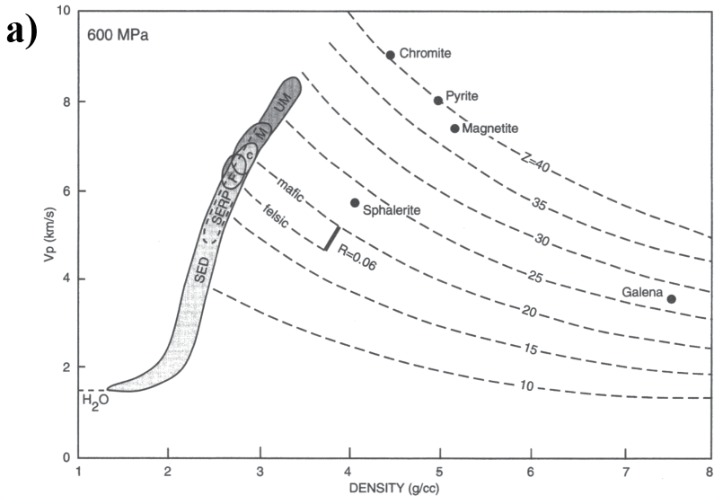
Hard rocks and Nafe-Drake

Slide 17
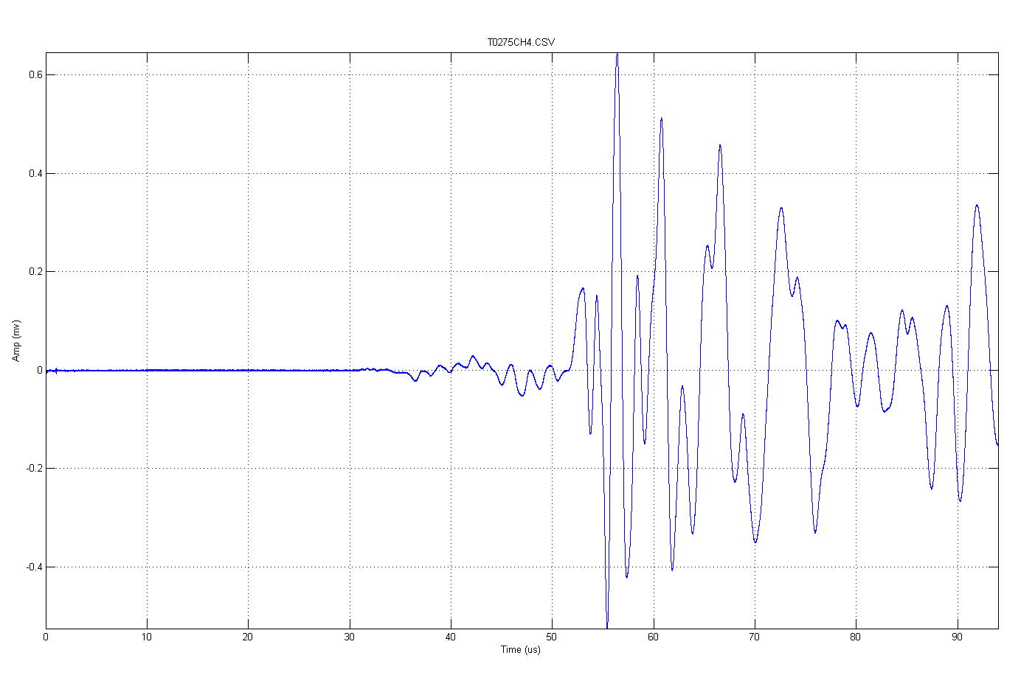
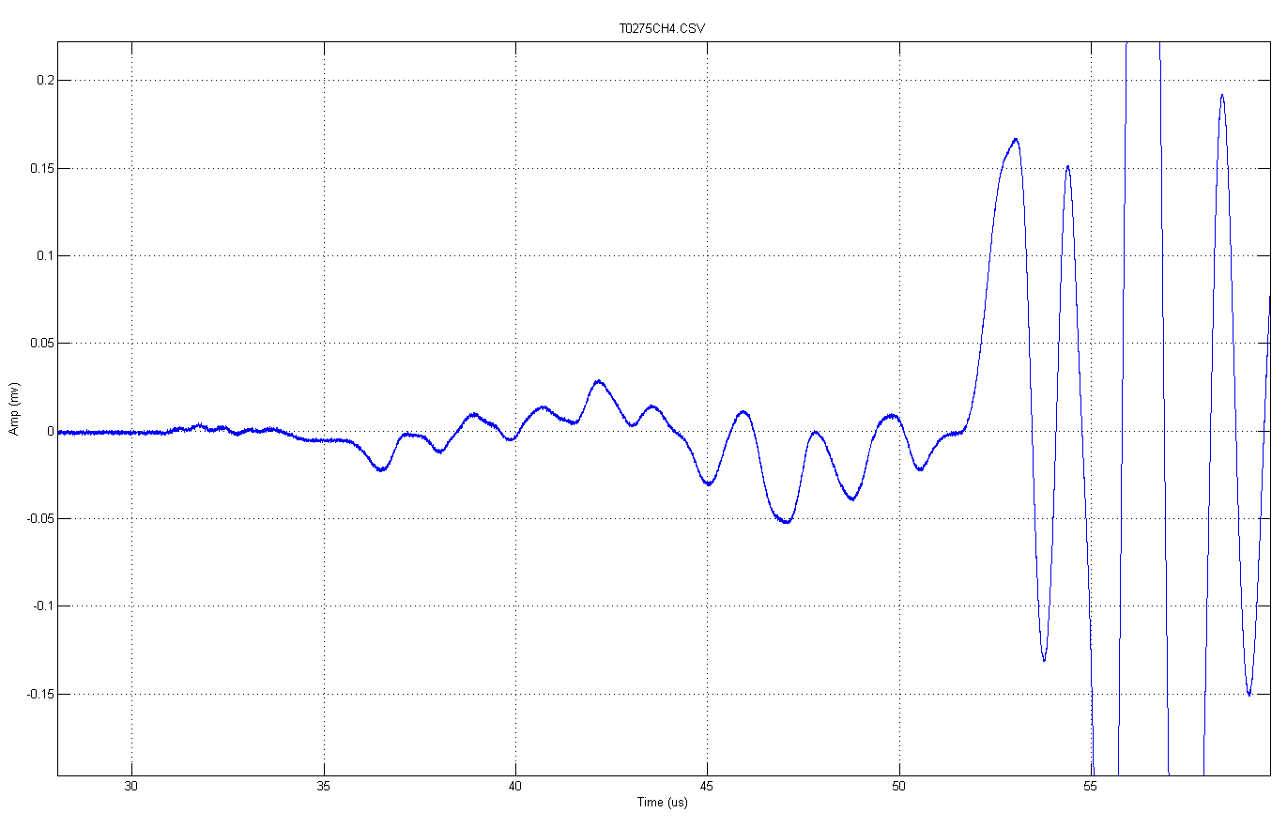
Hard rocks – ultra sonic
Figure 7 (A) Full waveform for T0275 and (B) black box zoomed to discriminate the P-wave arrival time (orange dashed line) and S-wave arrival time (red dashed line).

Slide 18
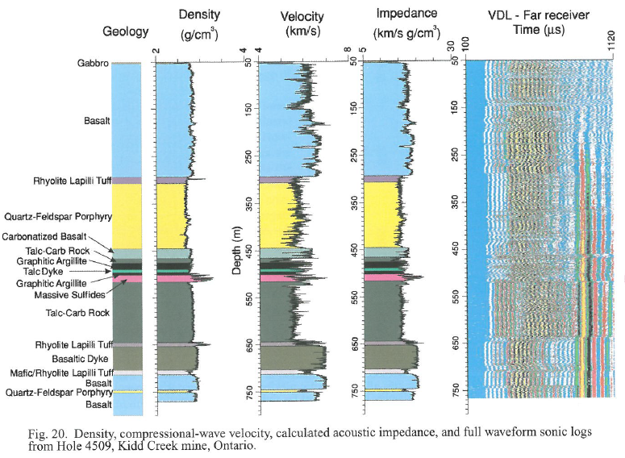
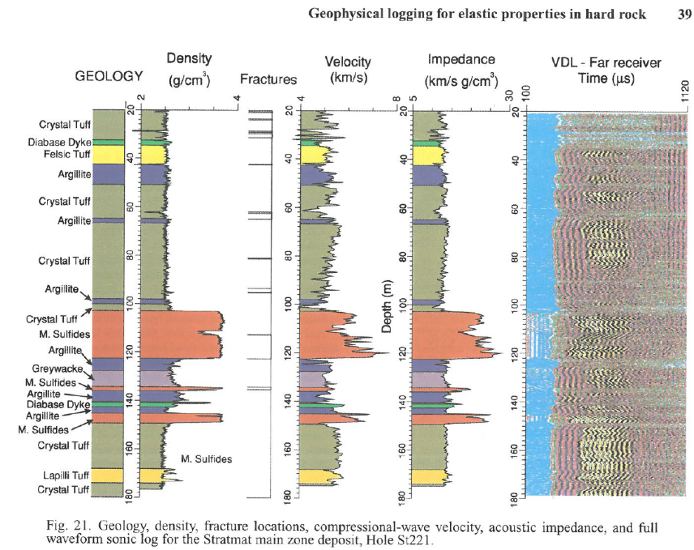
Massive Sulphides (VMS deposits)
Velocity can not accurately discriminate massive sulphides from mafic rocks independently.
Observable effect of fractures on velocity and amplitude response of wavefileds
(Schmitt, 2003)

Slide 19
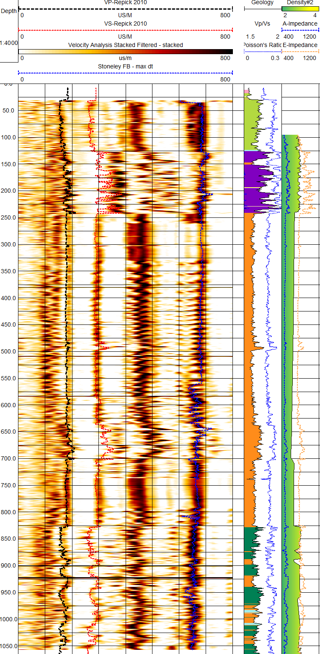
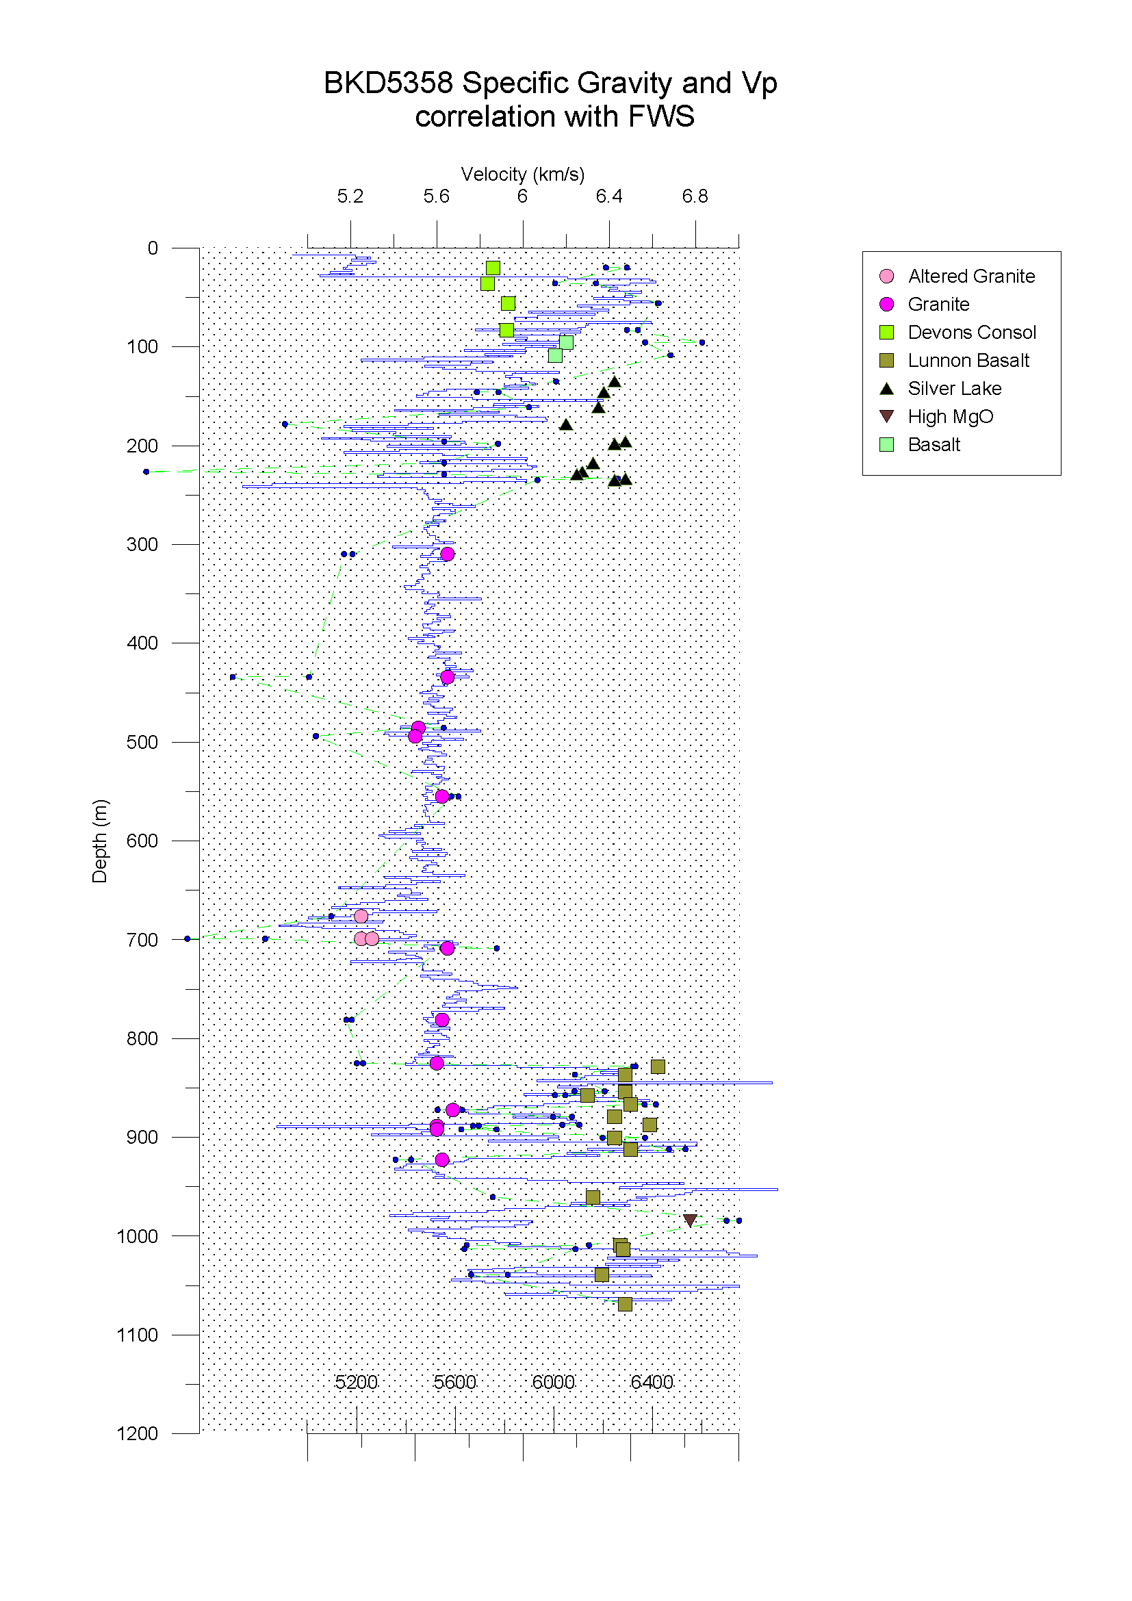
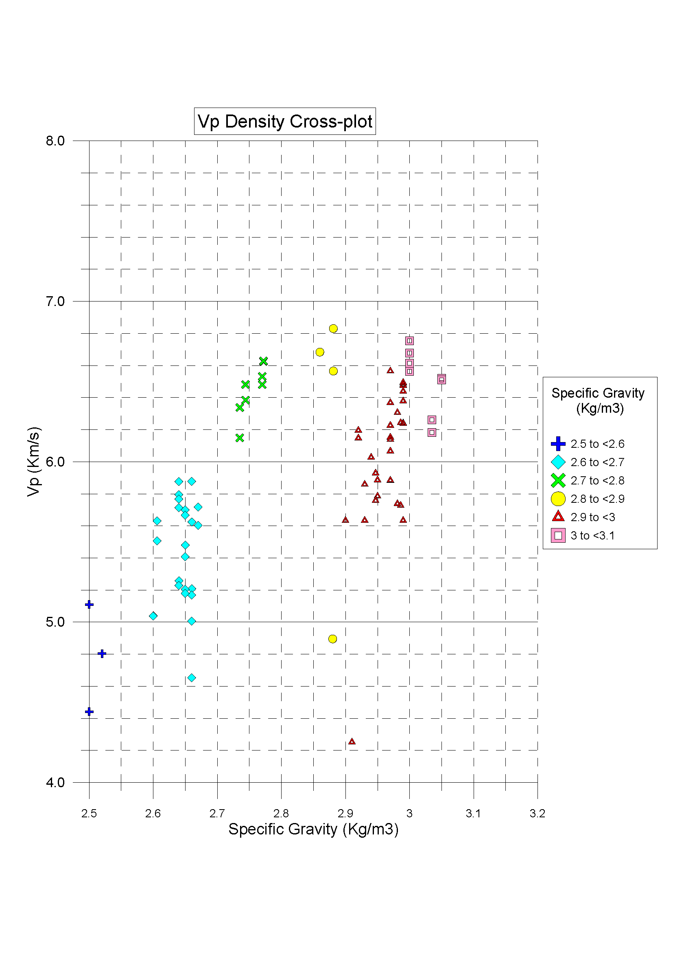
Kambalda

Slide 20
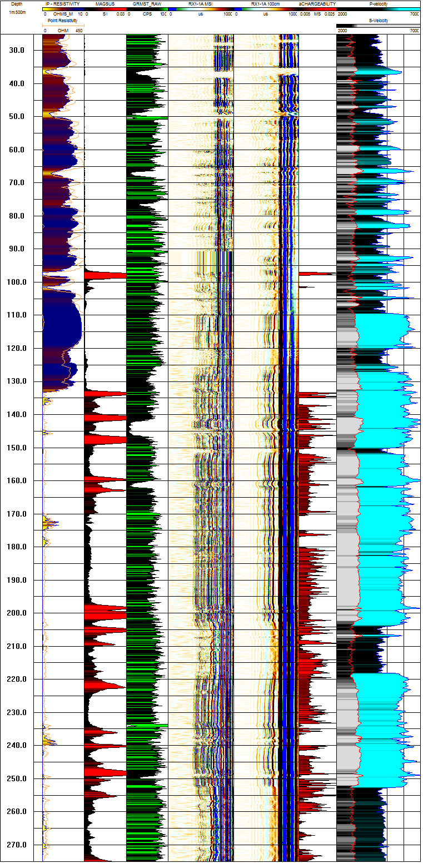
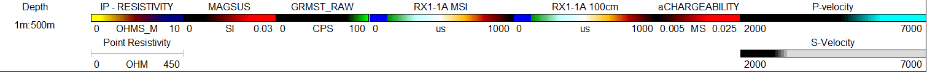
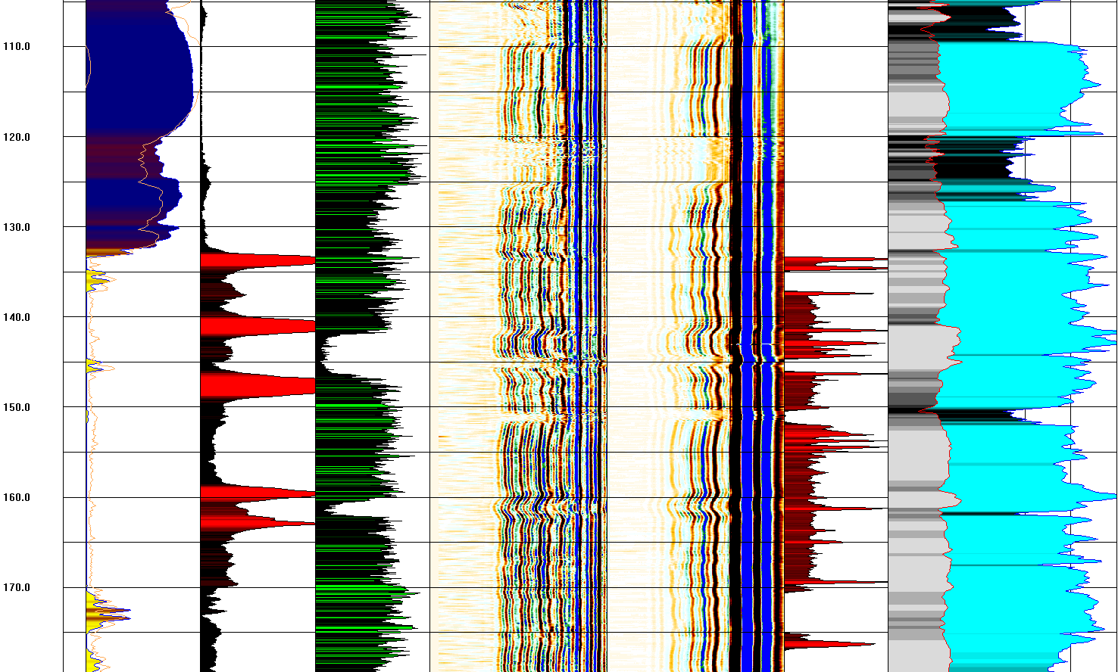
Brukunga
MSI – 30kHz
GV – 28kHz

Slide 21
Summary
Signal
Hard rocks are highly elastic resulting in low amplitude compressional waves
Piezo electric signal is broad band (hard to shape wavelet) and has a long wave train.
Long wave train results in overlapping wavefields
Multiple higher modes at higher frequencies
Acquisition – best field practices need to be employed to increase SNR
Stack data, slow acquisition speeds (2m/min) especially in deviated boreholes
Correct centralisation – reduce road noise and prevent first arrival smearing
Longer tools to separate wavefields

Slide 22

Summary II
Processing
Do not band limit your data
Frequency panel tests ?
Future considerations
Tool and source design for high velocity formations
Full $fk$ modal analysis and or deconvolution.

Slide 23
References
Almalki, M., B. Harris, and J. C. Dupuis, 2013, Multifrequency full-waveform sonic logging in the screened interval of a large-diameter production well: Geophysics, 78, B243-B257.
Close, D., D. Cho, F. Horn, and H. Edmundson, 2009, The Sound of Sonic: A Historical Perspective and Introduction to Acoustic Logging: CSEG Recorder, 34-43.
Eaton, D., S. Guest, B. Milkereit, W. Bleeker, D. Crick, D. Schmitt, and M. H. Salisbury, 1996, Seismic imaging of massive sulfide deposits; Part III, Borehole seismic imaging of near-vertical structures: Economic Geology, 91, 835-840.
Ellis, D. V., and J. M. Singer, 2007, Well logging for earth scientists: Springer Science & Business Media.
Haldorsen, J. B., D. L. Johnson, T. Plona, B. Sinha, H.-P. Valero, and K. Winkler, 2006, Borehole acoustic waves: Oilfield Rev, 18, 34-43.
Hornby, B. E., 1989, Imaging of near-borehole structure using full-waveform sonic data: Geophysics, 54, 747-757.
Schmitt, D. R., J. Mwenifumbo, K. A. DPflug, and I. L. Meglis, 2003, Geophysical logging for elastic properties in hard rocks: A tutorial., in D. Eaton, B. Milkereit and M. H. Salisbury, eds., Hardrock Seismic Exploration: Society of Exploration Geophysicists.

